Slide 1
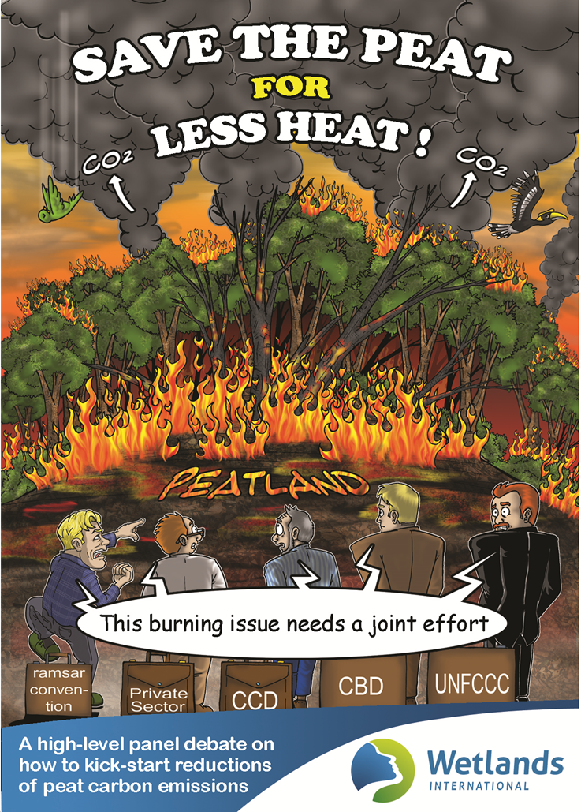
UNFCCC
Cop 21 Paris
Experiences on implementation of ecosystem-based approaches to climate change mitigation in
peatlands
Rio Conventions Pavilion
December 1, 2015

Slide 2
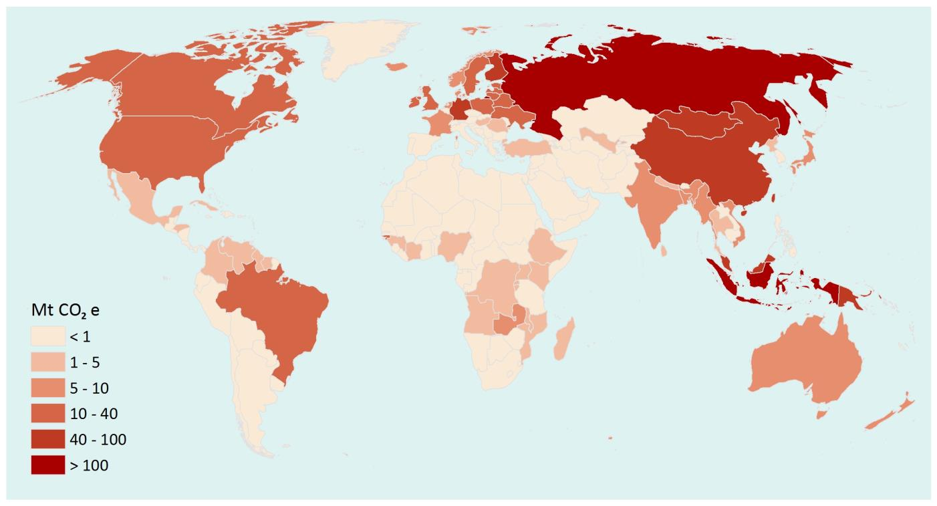
Emissions from peatlands per country indicating which countries contribute most to global peatland emissions and where it is most urgent to undertake peatland rewetting action
Rio Conventions Pavilion
December 1, 2015

Slide 3
Emissions from peatlands per unit national land area (in tCO₂e/km²) indicating where peatland emissions are most relevant for land use policies
Rio Conventions Pavilion
December 1, 2015

Slide 4
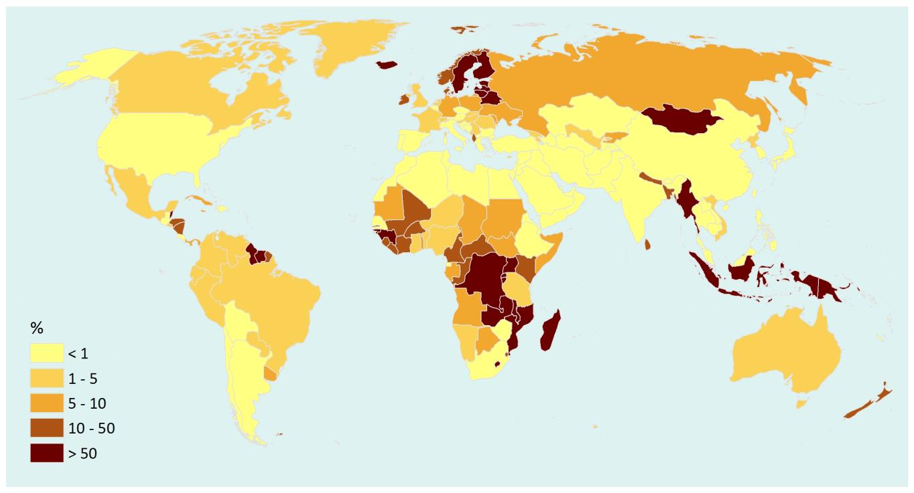
Peatland emissions as % of national fossil fuel and cement emissions indicating the importance of peatlands for national climate policies
Rio Conventions Pavilion
December 1, 2015

Slide 5
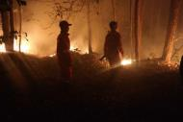
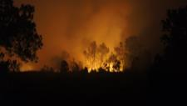
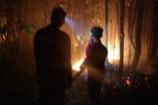
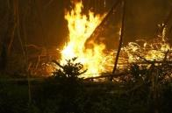
Experiences in SE Asia: Indonesia

Slide 6
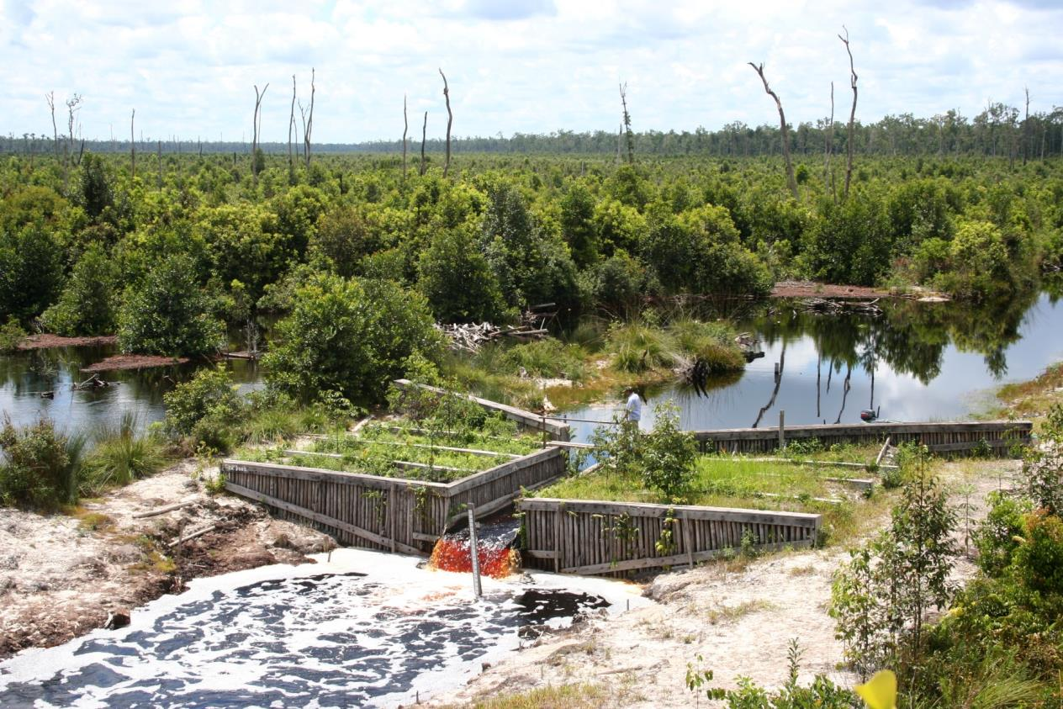
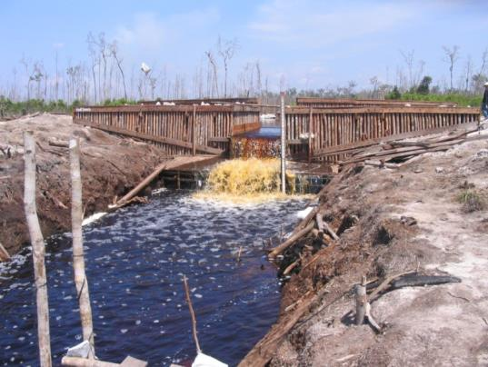
Peatland rewetting, Central Kalimantan
Hydrological restoration stops emissions and restores biodiversity

Slide 7
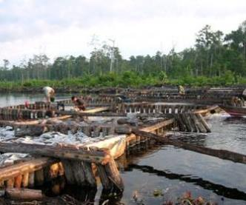
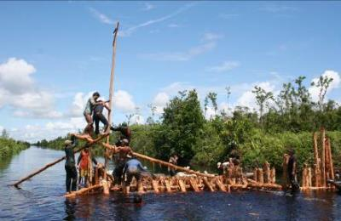
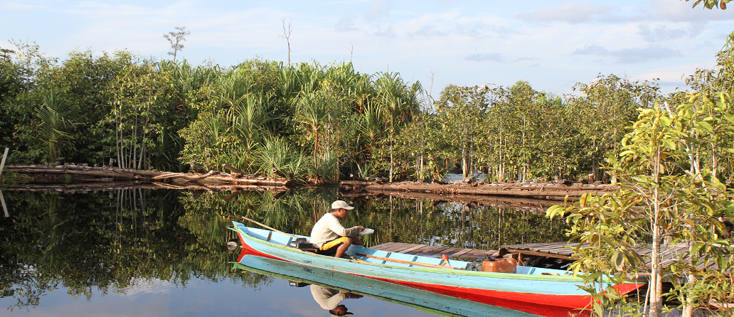
Community-based
Building dams using traditional techniques
Employment & benefit sharing
Paludiculture: sustainable income
2003
2012
Local stakeholders must benefit

Slide 8
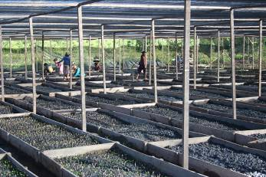
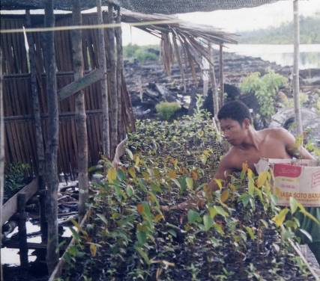
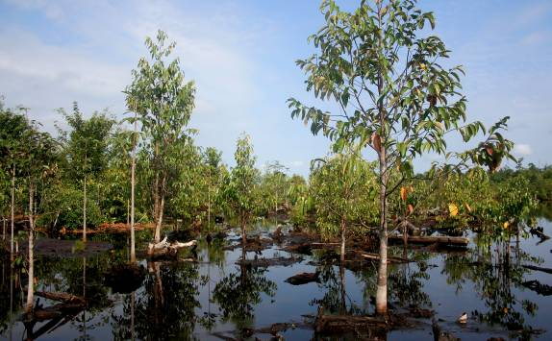
Communities replant degraded peatlands
Paludiculture, Central Kalimantan
Reforestation

Slide 9
Experiences in Europe: Russia

Slide 10
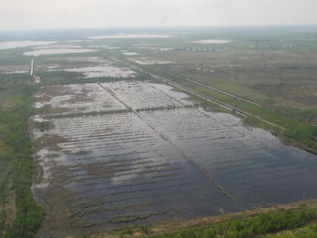
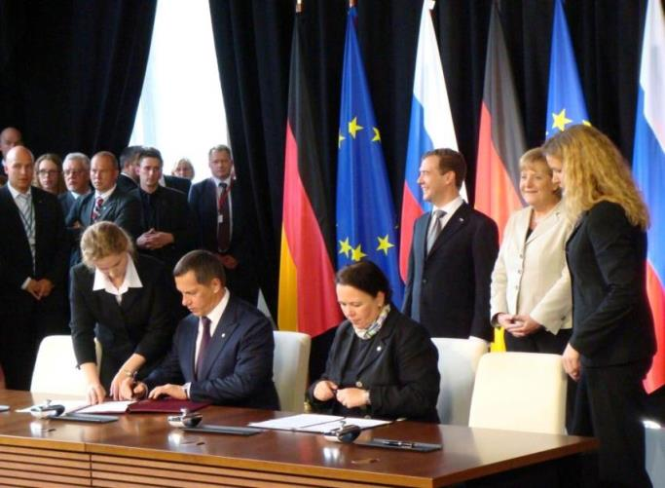
The PeatRus project
Response to large peat fires around Moscow in 2010
High level bilateral decision for international collaboration and exchange of expertise.
German (IKI) finance: € 5 million
Russian finance: € 35 million
Implemented under the German International Climate Initiative (IKI)
Facilitated through German Development Bank (KfW)
Managed by Wetlands International

Slide 11
Identifying and mapping peatlands (inventory)
Moscow Province
Peatbogs and peatlands
250 000 ha or around 6% of the total province area;
Total number of sites > 1700
Sites from 2.5 to 26,000 ha
Restored 70,000 ha

Slide 12
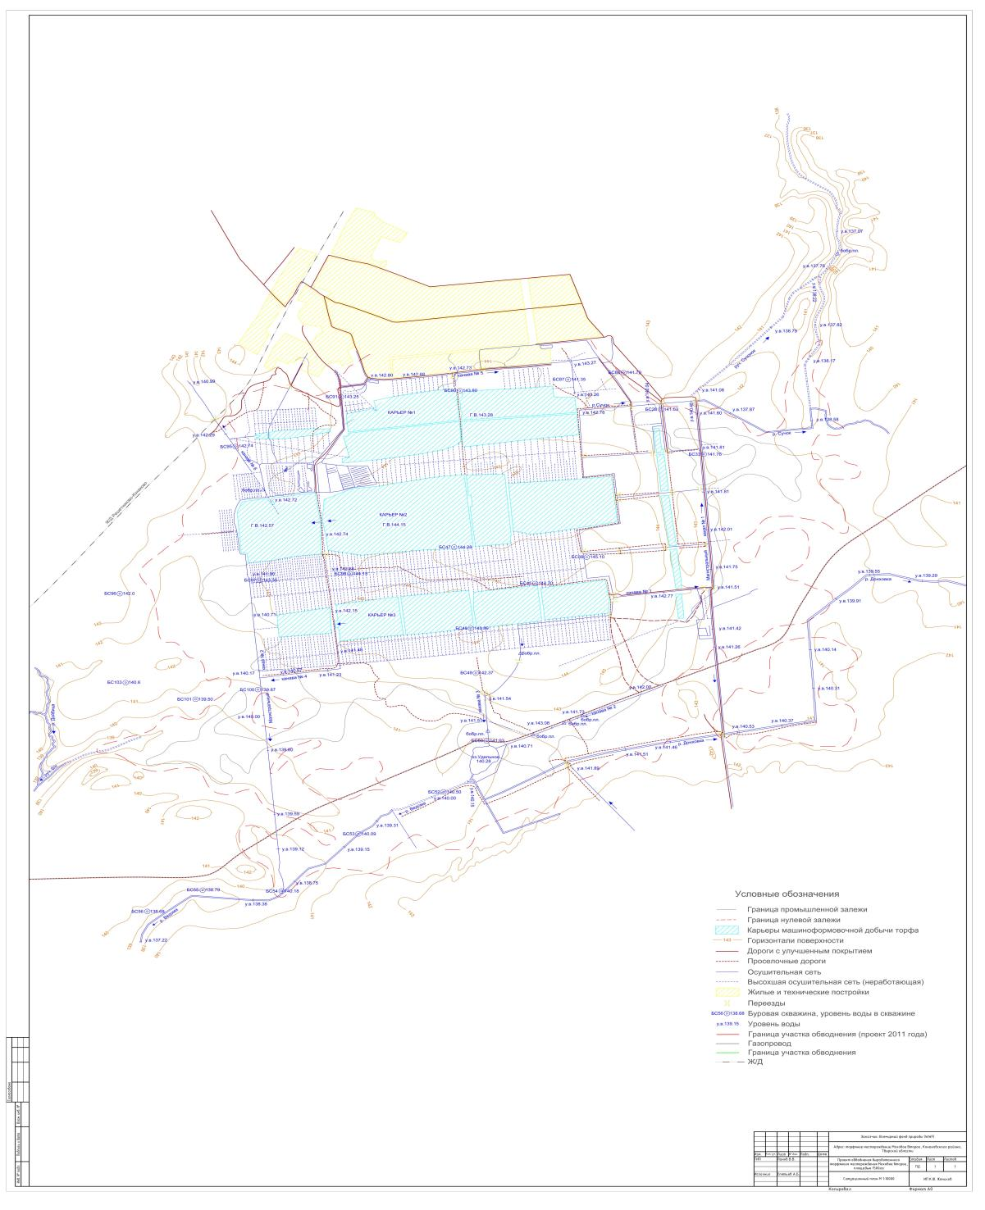
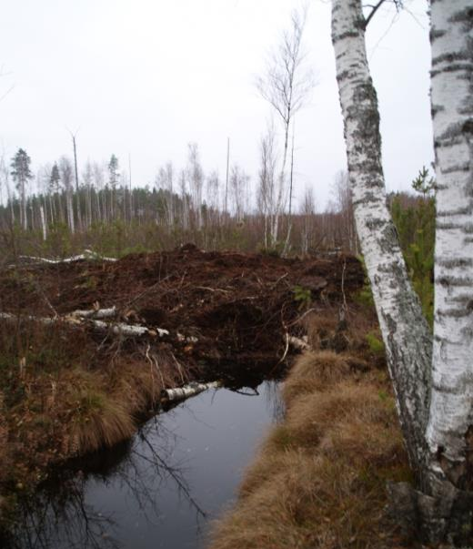
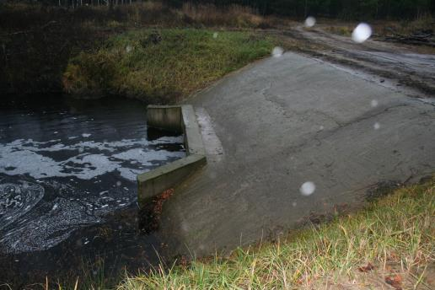
Costs of rewetting
Preparation & planning (design)
Implementation
Maintenance & operation
Other (monitoring, taxes, etc.)
Ecological approach significantly
cheaper than hydro-technical facilities
Larger sites less costly
Ecological rewetting: cheaper maintenance
Ecological rewetting ~ € 60 / ha
Hydro-technical rewetting ~ € 1.200 / ha
Rio Conventions Pavilion
December 1, 2015

Slide 13
Roadmap to accelerate action for peatland restoration
Wetlands International is starting a global programme for peatland restoration for climate change mitigation with the CBD, UNCCD and Ramsar Convention
Hotspot analysis of degraded peatlands
An online Global Peatland Hotspot Atlas
International collaboration for targeted finance
Capacity building and upscaling
Large scale implementation via major programmes
Rio Conventions Pavilion
December 1, 2015

Slide 14
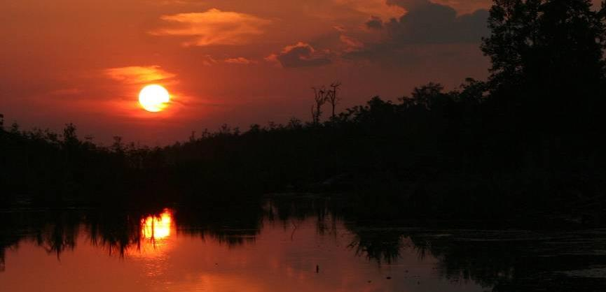
Thank
y u
We need to start a paradigm shift from unsustainable practices to Net Positive Impact
More information on www.wetlands.org

